Slide 1
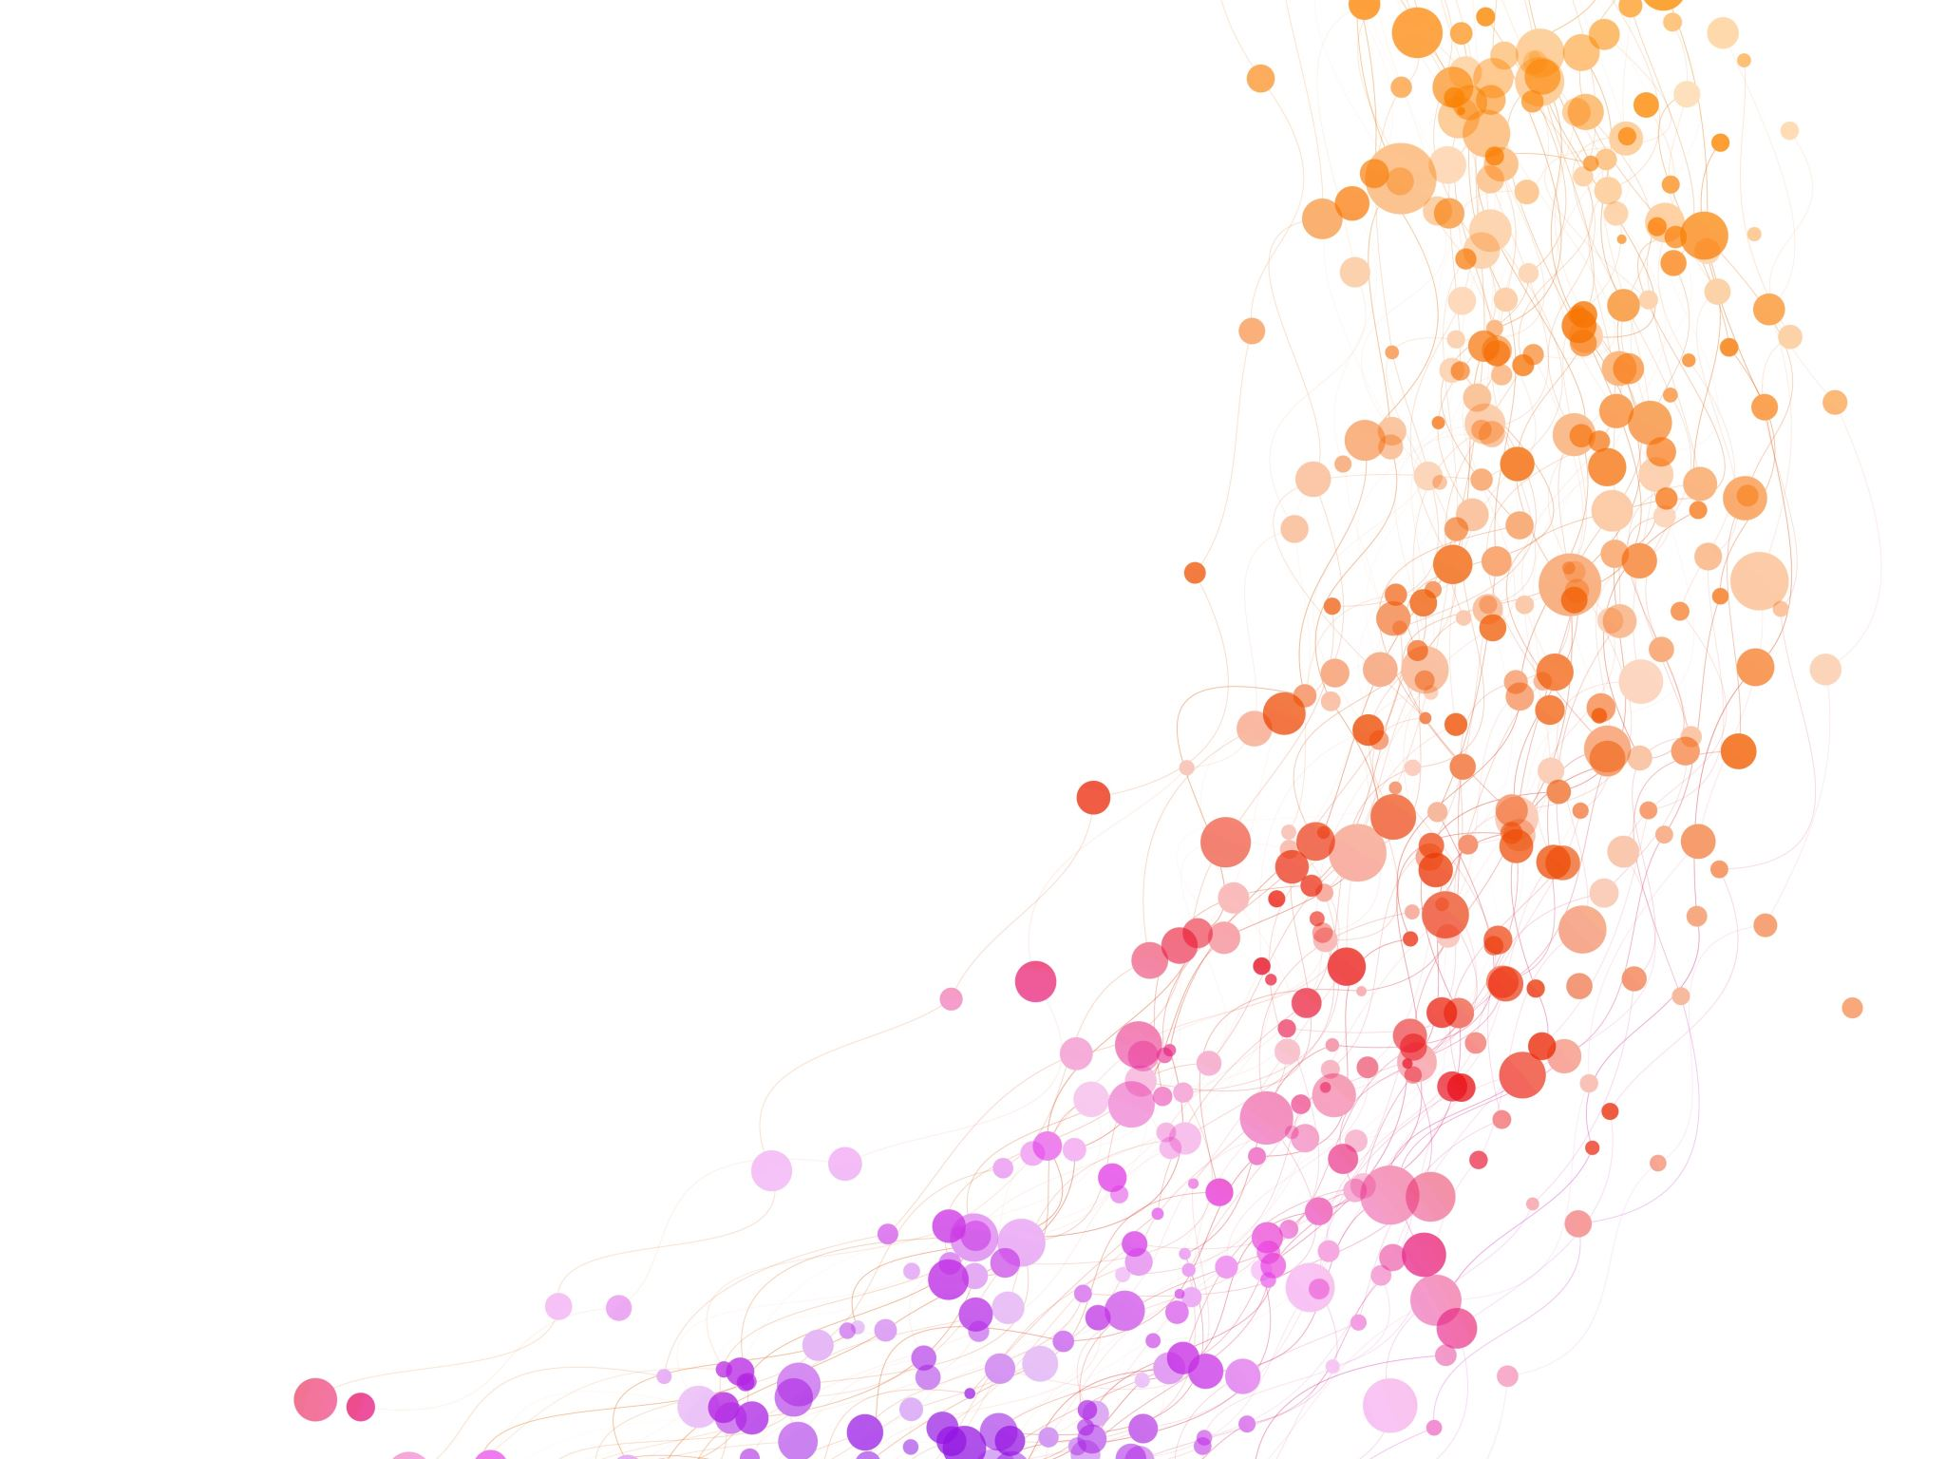
An Analysis Sparked By Lightening.
Team members: Hannah Carnes, Tiffany Conrad, Damla Duman, John Olton, Patrick Schulze

Slide 2
Project description/outline:
-Wildfire patterns month-by-month. -Check total number of fires over the years.
Datasets to be used: https://www.kaggle.com/datasets/aestheteaman01/278k-us-wildfires-due-to-lightning-2004-2015

Slide 3
Research questions:
What is each state's fire season based on month vs state?
Has fire fighting gotten more efficient/effective over time?
Have fire sizes changed over time? Is there a trend?
What state's have the most fires? Biggest fires?

Slide 4
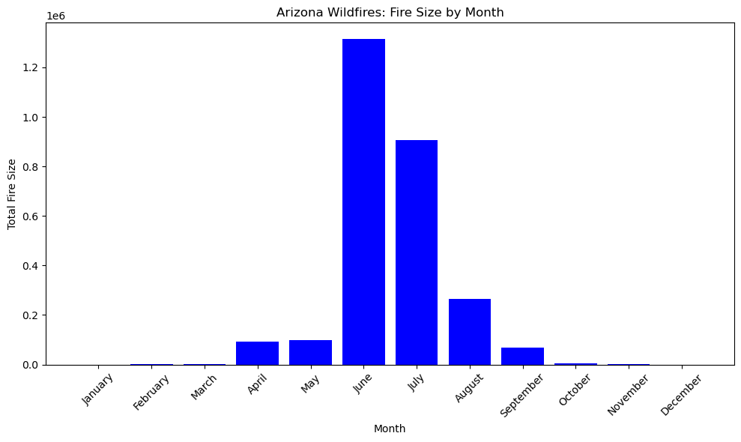
1.What is each state's fire season based on month vs state?

Slide 5
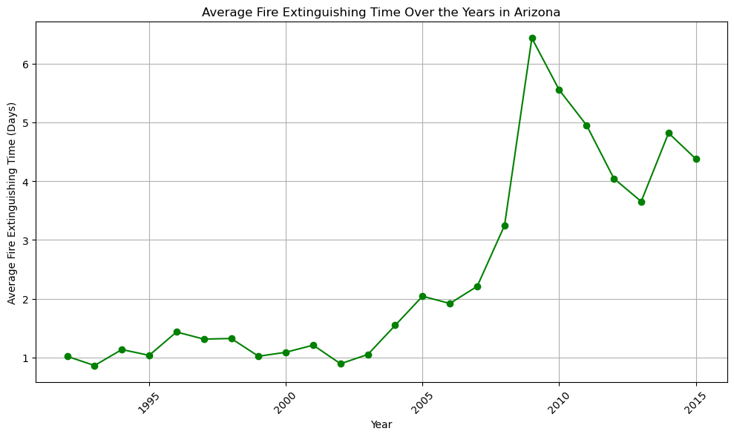
Has fire fighting gotten more efficient/effective over time?

Slide 6
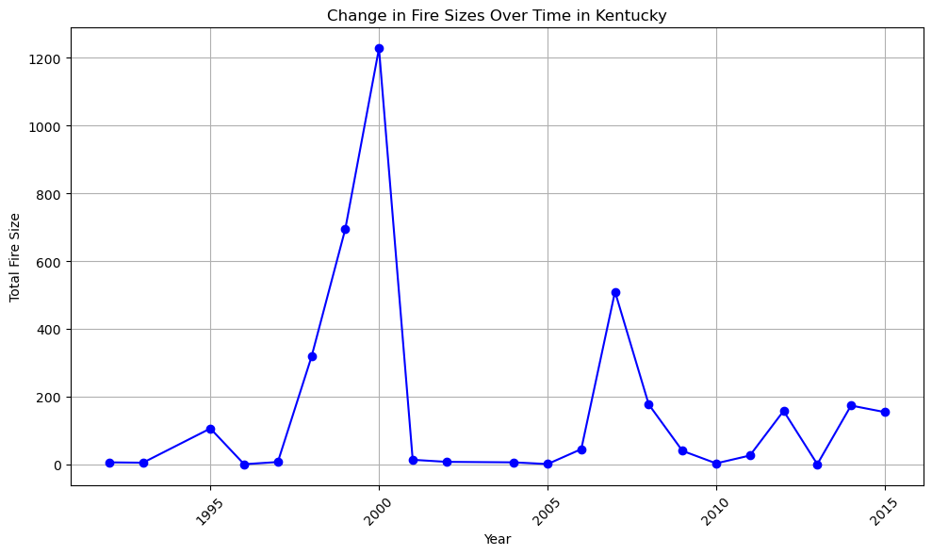
Have fire sizes changed over time? Is there a trend?

Slide 7
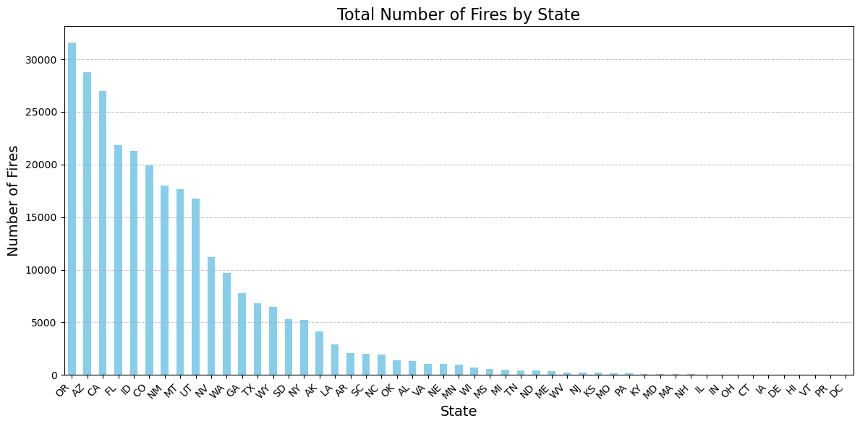
What state's have the most fires? Biggest fires?

